Slide 1

Pan Card Tampering
By
Khannchan.B

Slide 2
Computer Vision
Computer vision is a field of artificial intelligence that trains computers to interpret and understand the visual world. Using digital images from cameras and videos and deep learning models, machines can accurately identify and classify objects — and then react to what they “see”.
Computer vision tasks include methods for acquiring, processing, analyzing and understanding digital images
Computer Vision in Image processing is mainly focused on processing the raw input images to enhance them or preparing them to do other tasks. Computer vision is focused on extracting information from the input images or videos to have a proper understanding of them to predict the visual input like the human brain.

Slide 3
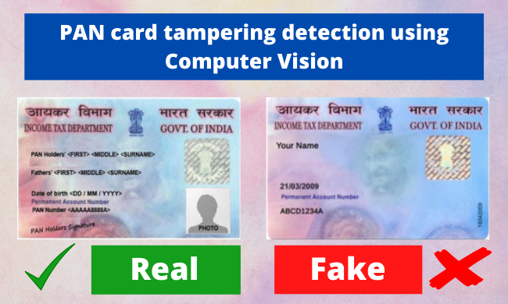

Slide 4
Scope
This project can be used in different organizations where customers or users need to provide any kind of id in order to get themselves verified. The organization can use this project to find out whether the ID is original or fake. Similarly, this can be used for any type of ID like Aadhar, voter id, etc.

Slide 5
Purpose
The purpose of this project is to detect tampering/fraud of PAN cards using computer vision. This project will help the different organizations in detecting whether the Id i.e. the PAN card provided to them by their employees or customers or anyone is original or not.
Using SSIM

Slide 6
The steps involved in this project are as follows :
1. Import necessary libraries 2. Scraping the tampered and original pan card from the website 3. Scaling down the shape of the tampered image as the original image 4. Read original and tampered image 5. Converting an image into a grayscale image 6. Applying Structural Similarity Index (SSIM) technique between the two images 7. Calculate Threshold and contours and 8. Experience real-time contours and threshold on images

Slide 7
Library Used
Skimage: Scikit-image, or ski-mage, is an open-source Python package, in this project most of the image processing techniques will be used via scikit-image
imutils: Imutils are a series of convenience functions to make basic image processing functions such as translation, rotation, resizing, and displaying images easier with OpenCV.
cv2: OpenCV (Open Source Computer Vision Library) is a library of programming functions. Here in this project major reading and writing of the image are done via cv2.
PIL: PIL (Python Imaging Library) is a free and open-source additional library for the Python programming language that adds support for opening, manipulating, and saving many different image file formats.

Slide 8
About SSIM Index
The Structural Similarity Index (SSIM) is a perceptual metric that quantifies the image quality degradation that is caused by processing such as data compression or by losses in data transmission.
How SSIM perform its function?
This metric is basically a full reference that requires 2 images from the same shot, this means 2 graphically identical images to the human eye. The second image generally is compressed or has a different quality, which is the goal of this index.
What is the real-world use of SSIM?
SSIM is usually used in the video industry but has as well a strong application in photography.
How SSIM helps in detection?
SSIM actually measures the perceptual difference between two similar images. It cannot judge which of the two is better: that must be inferred from knowing which is the original one and which has been exposed to additional processing such as compression or filters.

Slide 9
Thank you ☺

